Slide 1
Chemical Safety and Security Risk Management Industrial Perspectives, Risk Prioritization, Risk Mitigation, Risk Assessment and Training Modules for Risk Communication Hemantha Dodangoda Sri Lanka
Notes:
The major focus of this session will be on Chemical Risk assessment, Prioritization & Mitigation

Slide 2
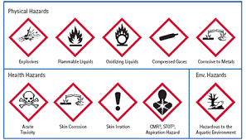
Chemical Safety and Chemical Security
Definition
“Chemical safety”
- Prevent non-deliberate releases of toxic chemicals into the environment and to mitigate the impact if such events occur.
- Chemical safety comprises disciplines such as occupational safety, public safety, process safety, environment safety, consumer safety and transport safety.
“Chemical security”
Prevent deliberate releases of toxic chemicals and to mitigate the impact if such events occur.
In a wider context, it also includes policies to prevent attempts to acquire toxic chemicals or chemical weapons precursors.
Notes:
Chemical safety and chemical security can be referred to measures taken at the governmental and private enterprises to ensure that chemistry is practiced in a safe and secure manner.

Slide 3
Integration
Chemical Security and Chemical Safety
Objectives of Integrated Chemical safety & Security risk management
Chemical Safety Management
More effective risk reduction
Better communication
Increased safety and security culture
More effective use of limited resources
Integrated Risk Management
Chemical Security Management
Notes:
Individual program on Chemical safety and Security will not be impactful enough to control both chemical safety related accidents & Chemical security related incidents, Hence integrate system of both will have to be implemented at any level, i.e from National level to Organizational level.

Slide 4
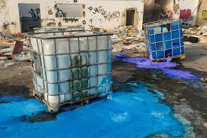
Chemical safety and chemical security?
Impact
Managing chemical risk ensures protection of:
Workers
Plant facilities
Plant processes
Community
Environment
Economy
Notes:
The ultimate positive impact is on the entire cycle of sustainable Socio - economy

Slide 5
Integrated approach to Chemical Safety and Security
Risk Management
The predominant principles of both safety and security are,
“Prevent” - Understanding of and implementation of measures to reduce the potential for a chemical accident or security incident to occur.
- A chemical accident may include an accidental release of chemicals into the environment, accidental exposure of a chemical.
A chemical security incident may include the theft of chemical materials for subsequent misuse or the malicious release of chemicals into the environment.
“Detect” refers to systems and processes that support the early detection of a chemical release or loss, and the confirmation of chemical use following a suspected release (either accidental or malicious). Detection systems should also incorporate risk communication process.
“Response” refer to both facility level response and national level response to a chemical accident or chemical security incident. Response systems include the engagement, equipping, and training of responders, such as fire, hazmat, emergency, and police.
Notes:
The key three principles which provide basement for integrated Chemical safety & Chemical security risk management program are Prevent, Detect, & Response.

Slide 6
Prevention Laws, Regulations, Policies in Sri Lanka, regarding Chemical Management
Legal Setup of Sri Lanka
Chemical Weapons Convention Act No. 58 of 2007 – A National Legislation for the enforcement of the convention has been approved by the Sri Lanka Parliament
Gazette No. 1561/23. Issued by the Ministry of Industrial Development on 15th August 2008 – Regulations framed under section 39 & 24 of the Chemical Weapons Convention Act No. 58 of 2007
Gazette No. 1627/1 issued by the Ministry of Finance & Planning on 09th November 2009 – Regulations framed under section 20(3) & (4) and section 14 of the Import & Export Control Act No. 1 of 1969
Chemical Weapons Convention act No. 58 of 2008 and regulations extraordinary No. 1561/23 of 07/08/2008
Control of Pesticides Act No. 33 of 1980 – Regulation of imports, restriction and ban of pesticides through registration and gazette notification
Imports and Exports (Control) Act No. 1 of 1969 – Regulation of import of industrial chemicals (except for Board of Investment requirements)
National Environmental Act No. 47 of 1980 – Limited provisions for regulation thru licensing procedures
Factory Ordinance of 1946 – Occupational health aspects relating to the industrial chemicals
Explosive Act No. 21 of 1956 – Excise ordinance
Customs Ordinance – Import and export of regulated industrial chemicals
Inter‐agency Coordinating Procedure of Basal, Stockholm and Rotterdam Conventions
Important Articles: Annex III – Pesticide formulations and industrial chemicals under Prior Informed Consent (PIC) Procedure
Notes:
Country level there are set of Acts & Regulations with legal enforcement. In addition Sri Lanka is align with many other International conventions.

Slide 7
Prevention
Strategy of Sri Lanka
Strategies adapted by national authority
Registration of Scheduled Chemicals users
Issue import / export recommendations
Assist in Chemical emergencies
Provide awareness for industrialists related to scheduled chemicals
Provide awareness for persons handling hazardous chemical materials
Provide general awareness to all stake holders
Conducts client based educational addressing sector based issues
Adopt necessary measures to ensure that toxic Scheduled Chemicals and their precursors are only used for peaceful purposes
Collect data on hazardous chemicals
Develop National Protection Programme
Dealing with media
Notes:
Involvement of Many other government authorities and national bodies are in combination with each other to ensure effective Chemical safety & security management system all across the country. It relates to key stages such as Vendor registration, Purchasing & Distribution, Retail & wholesale supply, storage, application, waste management & final disposal etc.

Slide 8
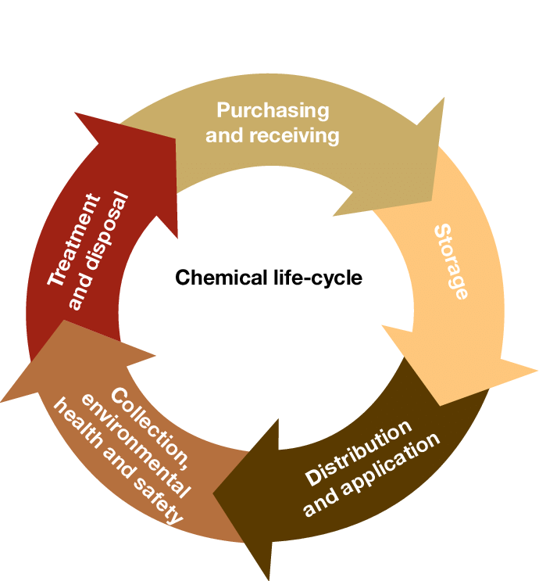
Lifecycle of Chemicals
Life Cycle
Notes:
Here is the life cycle of chemical which closely identified, evaluated, assessed, controlled & monitored with help of Integrated Chemical Risk management program by Competent Professionals & regulatory bodies.

Slide 9
Prevention
Organizational Approach
Inventory Management systems
Hazard Assessment Tools
Risk Assessment Tools
Chemical Safety and Security Guidance documents
Chemical Safety and Security Training
Notes:
Now onwards, will see how the industries are arranged to Ensure how they handle chemical safely & securely in their end to end supply chain.
Here are the key pillars defined under Risk Management Program for Chemicals.
Hazard Banding inventory.

Slide 10
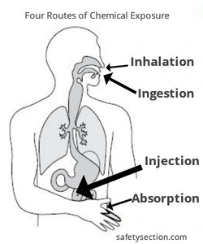
Chemical Hazard
Overview of Chemical Hazard
Risk associated with operations/ task which involves storing, handling or producing hazardous substances that could cause adverse health effects & environmental impacts
Inhalation of hazard vapors, powders, fibers & fumes
Dermal irritation/ Sensitization due to skin contact
Ingestion of hazardous substance
Chemical burning (Corrosive)
Spillage of hazard material
Notes:
Before move further, see the visual illustration of routes of entry of hazardous chemicals into the body. Chemicals are in different forms of such as dusts, fumes, vapors , sprays and those can be entered into body via routes of entry.

Slide 11
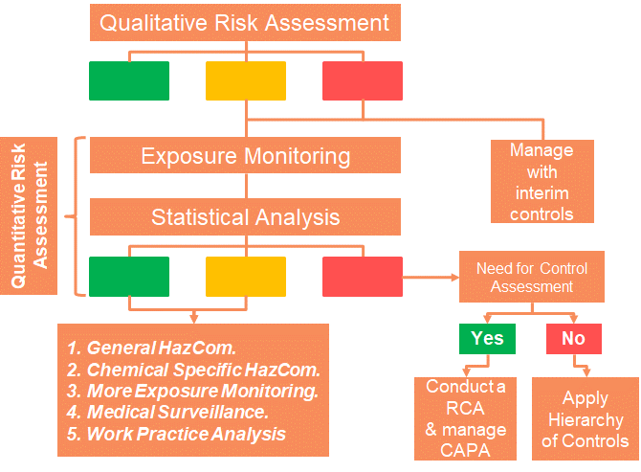
Chemical Risk Management Approach
Strategy
Notes:
Two risk assessment approach
Categorized into two
Here we talk Similar Exposure Group

Slide 12
Qualitative Risk Assessment
Pre work
Collection of Data
Details of operation or tasks to be assessed
Location
No of employees involved
Process steps (Weighing, additions, mixing, heating, cooling, discharging, emissions, etc..)
Tasks/ steps where potential exposure can occur
List of hazardous substances used/ releases
Physical and chemical properties of hazardous substances (SDS)
Health hazard notations of substances (GHS)
Occupational Exposure Banding (OEB)
Amount of materials used or release
Effectiveness of current controls and level of controls
Task duration and frequencies
Notes:
To initiate Chemical Risk assessments, set of information are needed beforehand.

Slide 13
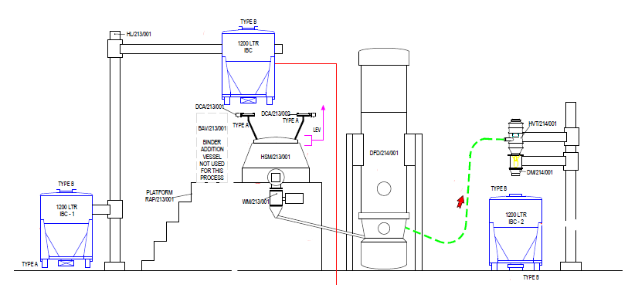
Identifying the chemical risk assessment scope
Pre Work
Undertake a ‘Red Dot’ Diagram to identify the scope
To determine the work load, a red dot diagram, identifying all potential exposure points in the operation is undertaken. You should Obtain a process flow to become familiar with the ‘exposure-prone’ tasks
Exposure prone tasks involve: getting chemicals INTO and OUT OF vessels, cleaning equipment and in some cases – running and operating the equipment itself, and taking samples for Quality Control & Assurance
Notes:
At the end of the information collection, red dot diagrams to be formed. Red dot diagram is a comprehensive process map with hazard identification. i.e Each of the process step will be carefully assessed in detail to identify all possible exposures. Red dots indicate such exposure points. This method will ensure that all the exposure points are identified by the assessors despite of the nature of the task ( Routine, non routine, emergency etc)
The assessment team should be comprised the representatives from HSE, Process, Engineering , quality assurance, Occupational hygiene, Occupational health ( Optional), material handling, etc

Slide 14
Chemical Risk Assessment
Qualitative Risk Assessment
The foundation of Hazard x Exposure determinations to arrive at Risk, considering..
QUALITATIVE RISK ASSESSMENT
Ref No | Operation (Briefly describe potential sources of exposure) | Substance or Mixture | Route of exposure Skin (sk), Inhalation (Inh), Ingestion (Ing) or Injection(Inj)) | Chemical Risk Evaluation Matrix
 |  |  |  | Risk Based Parameters See Table 1 |  |  |  | Exposure Score Ranking See Table 2 |  | Risk Rating See Table 3
 |  |  |  | Volume Rating (V) | Dustiness/ Volatility Rating (DV) | Engineering Containment Rating (EC) | Frequency/ Duration Rating (FD) | Total Score (V*DV*EC*FD) | Exposure Score (1-5) | Red, Amber or Green Rating
1 | Chemlock application | Xylene Chemlock 205 | Skin (sk), Inhalation (inh) | 3 | 2 | 1 | 3 | 18 | 2 | 2
Source of Exposure
Chemical in use
Exposure route
Notes:
In Qualitative Risk assessment conduct per each selected process,
Step 1: List down each step with possible chemical exposure as per the red dot diagram, each step with unique identification number for future reference (Column 1 & 2)
Step 2: List down names of each & every chemical ( as a substance or as a mixture) (Column 3)
Step 3: Mark the route of Exposure ( This can be correctly identified from MSDS / MSD / Data labels ) (Column 4)
Step 4: Risk based parameters should be marked with the help of Table 1
Step 5: Total score under Exposure score rating can be done by the multiplication of all four ratings received under Risk based parameters
Exposure score can be read from table 2 in related to Total score.
Step 6: Based on the given OEL ( Occupational Exposure Level), Risk category of the chemical can be defined (See tab3)
Locate the Risk index for particular task with the help of Exposure score & Risk Category defined based on OEL.
So this Final score is the “ Qualitative Risk Index Value’.

Slide 15
Establishment of Risk
Qualitative Risk Assessment
Exposure based parameters are multiplied to give an overall EXPOSURE score ….. volume, dustiness/volatility , existing controls with operator impact, frequency/duration
Score Value | Volume Scale Definitions (V) | Dustiness or Volatility @ 20°C Operating Temperature (DV) | Engineering Control and Operators Intervention Rating Scale Definitions (EC) | Frequency and Duration Scale Definitions (F)
0 |  |  | Closed system; no potential for release to work area. No operator intervention. E.g. transfer of a liquid chemical from a tank to a vessel via closed pipe work.
1 | Low volumes - <1kg or liters | Low Dust - Granules or pellets Low Volatility* | Primarily closed systems where effective engineering controls are in place to control exposure at potential contact points. Minor operator intervention. E.g. Isolator, Drum Containment System (DEC), Stand alone Spilt Butterfly Valves system, Continuous Liner with Laminar Flow Booth. | Infrequent & very short
2 | Small volumes 1 to 20 kg or litres | Medium Dustiness - Crystalline granular | Open system; engineering controls in place to contain/remove airborne chemical agent to reduce the operator exposure. Minor operator intervention. E.g. Standard Continuous Liner, Laminar Flow Booth with guards | Infrequent & short
3 | Medium volumes 20-150 kg or liters | High Dust – Fine Light Powders Medium Volatility* | Combination open and closed system; a combination of engineering and administrative controls in place to control exposure. Moderate operator intervention. E.g. Standard Laminar Flow Booth, Local Exhaust Ventilation. | Frequent & Short
4 | Large volumes 150-500 kg or liters | Persistent Dustiness - Very fine powders, micronised API | Open system; ineffective or no engineering controls in place. Major operator intervention. | Frequent & Medium
5 | Bulk volumes > 500 kg or liters | Penetrating Dustiness - Very Fine Dusts, Fine Micronized & Nanoparticles High Volatility* | Open system; no programme in place to minimize worker exposures; visual airborne contaminants, odors or sensory response indicate potential exposure exists. Major operator intervention | Always present
Exposure Based Parameters (Table 1)

Slide 16
Establishment of Risk
Qualitative Risk Assessment
Exposure Score Ranking (Table 2) & Risk Rating (Table 3)
Table 2
Exposure Score Ranking
Calculated Risk (V*DV*EC*FD) | Exposure Score
0 – 16 | 1
17 -44 | 2
45 – 94 | 3
95 – 200 | 4
201-625 | 5
The overall exposure score is multiplied by the category (Defined based on OEL) to give the
Qualitative Risk Index Value
Table 3
Red, Amber and Green Risk Rating
Exposure Score | Category 1 | Category 2 | Category 3 | Category 4 | Category 5
 | >1000–5000(μg/m3)/ >50–≤500 ppm | >100–≤1000(μg/m3)/ >5–≤50 ppm | >10–≤100 (μg/m3)/ >0.5 –≤5 ppm | >1–≤10 (μg/m3 )/ >0.05-≤0.5 ppm | ≤1(μg/m3)/ ≤0.05 ppm
1 | 1 | 2 | 3 | 4 | 5
2 | 2 | 4 | 6 | 8 | 10
3 | 3 | 6 | 9 | 12 | 15
4 | 4 | 8 | 12 | 16 | 20
5 | 5 | 10 | 15 | 20 | 25

Slide 17
What Next?
Quantitative Risk Assessment
Quantitative Risk Assessment
Qualitative CRA
IH Sample Plan
Manage Interim Control Programs
Standardize Work Practices
PPE & RPE
Health Surveillance
Hazard Awareness
Operator Competency in using interim controls
Bayesian
Notes:
If the Qualitative risk index value falls on red or amber region, risk mitigation plan is needed. The identified risks should be managed through interim control program till Industrial hygiene sampling to be performed for further assessment & subsequent decision.
Here is the beginning of Quantitative Risk assessment.
Q

Slide 18
Who do we sample?
Sampling
Quantitative Risk Assessment
Similar Exposure Groups
Industrial hygiene sampling data is taken for those risks identified from the qualitative risk assessment and is considered the quantitative risk assessment. Taking samples and analysing the data is the second step in our Chemical exposure risk lifecycle.
It is normally most efficient to group workers who have similar responsibilities and would be expected to have similar exposure to the same range of hazards; termed a ‘Similar Exposure Group’ (SEG).
SEG’s are groups of workers having the same general exposure profile for the agent(s) being studied because of:
The similarity and frequency of the tasks they perform;
The materials and processes with which they work; and
The similarity of the way they perform the tasks.
A statistically significant number of employees within each SEG should be monitored to obtain meaningful group ‘average’ exposures with 95% confidence limits.
Notes:
The initial step is to establish sampling plan. This will be lead, developed and stamped by occupational hygienist.
Similar Exposure Groups will be identified and significant number of employees within each SEG will be monitored through personal sampling to obtain meaningful group ‘average’ exposures
.

Slide 19
Statistical Analysis of Industrial Hygiene Data
Quantitative Risk Assessment
Use of Bayesian Statistics to assist in the assignment of exposure control ratings. It is designed for use with small n datasets, and can applied to a single measurement
It allows for statistically valid decision making with as few as 3 samples
It provides for Risk Management decision making based on defensible data
It provides a consistent process for IH decision making
Bayesian Statistics can do this by estimating the probability that the true exposure profile (95th percentile) falls into a particular American Industrial Hygiene Association (AIHA) exposure control category.
Notes:
Different statistical method can be applied for data analysis. Here the use of Bayesian statistics are used to assist in the assignment of exposure control ratings

Slide 20
Decision Making
Guidelines for interpretation of sampling results
Mean (average) result | Highest individual result | Action required
Average <0.1 × OEL | <0.25 × OEL | No further action required.
Average 0.1–0.25 × OEL | 0.25–0.5 × OEL | Verify results. Introduce monitoring programme (suggested frequency: 2-yearly).
Average 0.25–0.5 × OEL | 0.5–1 × OEL | Verify results. Increase frequency of monitoring (suggested frequency: 6–12-monthly).
Average 0.5–1.0 × OEL | >1.0 × OEL | Introduce interim control measures. Verify results. Reduce levels as soon as practicable.
Notes:
Simple & straightforward interpretation of results
If the average is less than 0.1 of OEL and the highest individual result is less than or equal 0.25 of OEL then no action is needed.

Slide 21
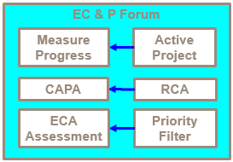
Chemical Exposure Risk Lifecycle
Action Planning
HSE and Engineering will together systematically determine and review:
What categorisation of chemicals are being used in a specific area throughout the site
What is the recommended engineering control approach to minimise the risk of personal exposures and where there control is insufficient
Where further assessment on determination of appropriate controls are required
Site IH Lead
Site Engineering Lead
Project Engineers
Site Production Lead
Site HSE Lead
Value Stream Engineers
Notes:
Action plan formation with the support of cross functional teams.

Slide 22
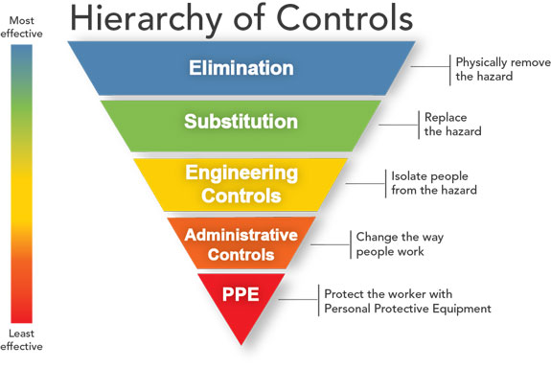
Risks Reduction and Control
Risk Management
Engineering Controls
Containment
Local Exhaust ventilation
General/ room ventilation
General design concepts
Procedure Controls
General controls achieved by good practices
Access and Egress
Adverse event and emergencies
Maintenance and Cleaning
Training
Exposure Monitoring
Notes:
Follow Hierarchy of controls.

Slide 23
Risks Reduction and Control
Risk Management
Administrative Controls
Training Calendar (Risk Driven)
Safe Work Procedures
Scheduled refresher
Permit to Work system
General and Specific risk communication
Access Control
Worker Rotation
Work or Production Planning
Management monitoring
PPE & RPE
Use correct RPE with suitable APF
Proper gowning to prevent skin contacts
Goggles
Gloves

Slide 24
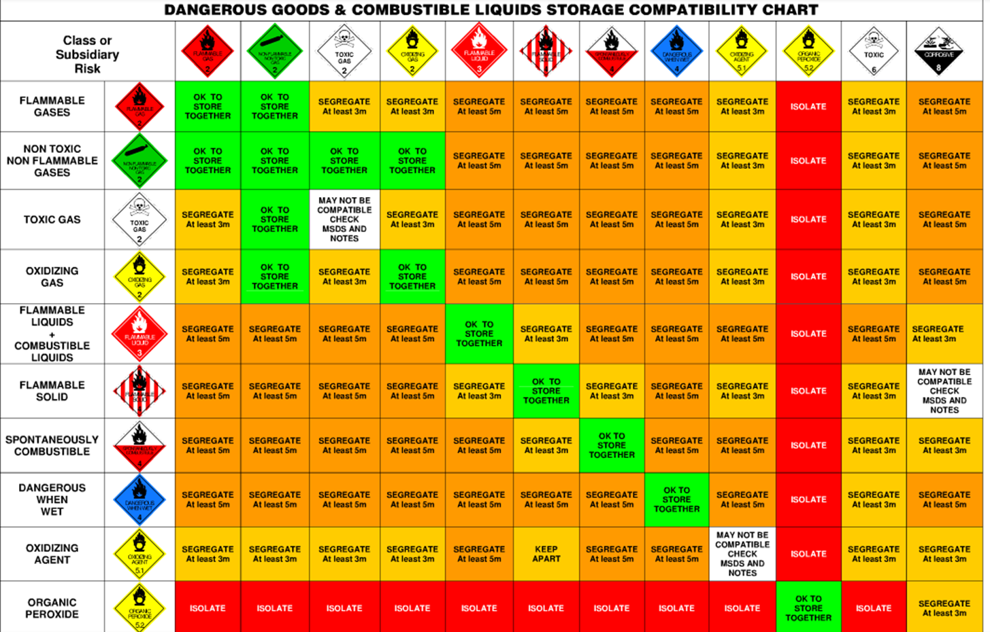
Storage – Compatibility Charts
Risk Management

Slide 25
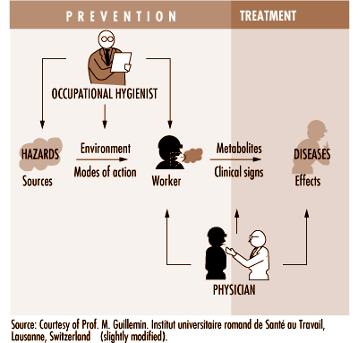
Scopes of Occupational Health and Industrial Hygiene
Risk Interpretation
Notes:
Occupational health and industrial hygiene each aim to improve workplaces. The former does this primarily by engineering the workplace to offer improved usability; the latter does so mainly by eliminating hazards. Many organizations need workers trained in these disciplines
Occupational hygiene is the science of the anticipation, recognition, evaluation and control of hazards arising in or from the workplace, and which could impair the health and well-being of workers, also taking into account the possible impact on the surrounding communities and the general environment.

Slide 26
Screening
Risk Based Health Surveillance
Sensitive
Specific
Based on risk
Minimally Invasive
Notes:
In parallel to the exposure monitoring program and progress of action plan to reduce risks , Health surveillance plan should be put in place by Occupational Health physician.
Priority should be given to define risk based minimally invasive surveillance mechanism.

Slide 27
Training & Hazard Communication
Training & Communication
Statutory
Company Standards and Work Procedures
Scheduled refresher
Risk based On time Hazard Communication

Slide 28
Training
Training
Training Content
The company’s chemical management policies and procedures
The types of chemicals used in the facility, as well as their hazardous properties
An overview of the manners in which workers or the environment may be impacted by the use or disposal of the types chemicals present at the facility
How to read and use the information contained in Safety Data sheet (SDS)
Procedures for the safe handling, use, and disposal of hazardous materials
Any additional requirements under applicable laws and regulations
Emergency Preparedness
Exposure monitoring and Health surveillance program

Slide 29
Q & A

Slide 30
Thank You

